Slide 1
Managing Inventory Products Application
-Soumik Chatterjee-

Slide 2
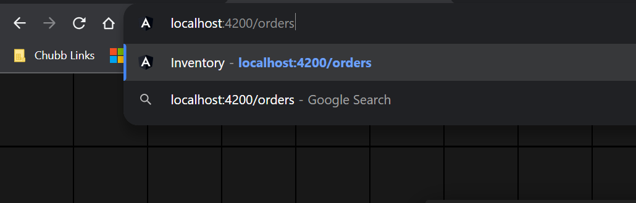
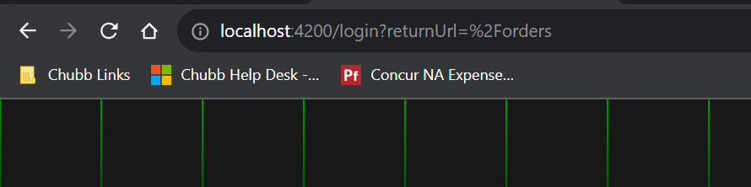
Authentication & Authorization
Auth guards are used to prevent unauthorized access to components before login.
Auth guards allow authorized users to navigate only to specific components based on their user role and permissions.

Slide 3
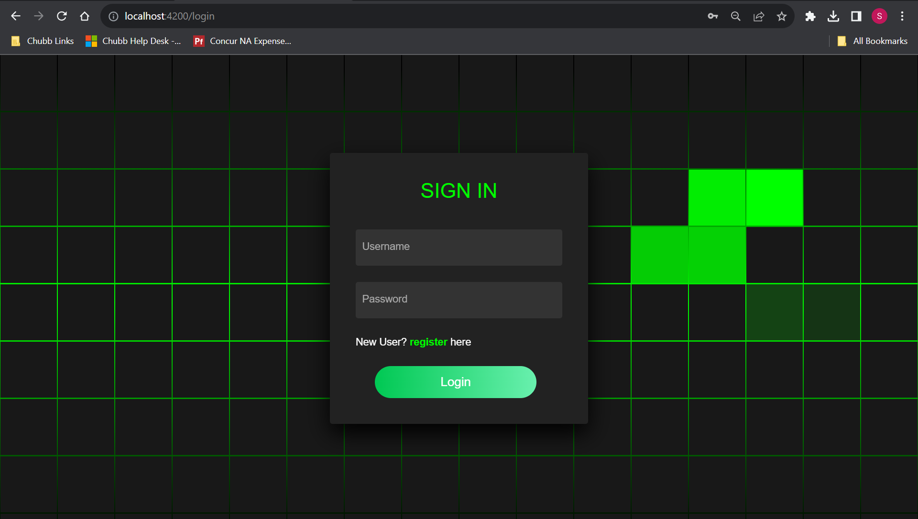
Login Page
The login page is the first page users see when they visit our site, and it requires the user to enter correct credentials to continue.
If users do not have an account, they can click the 'register’ hyperlink to create a new account.

Slide 4
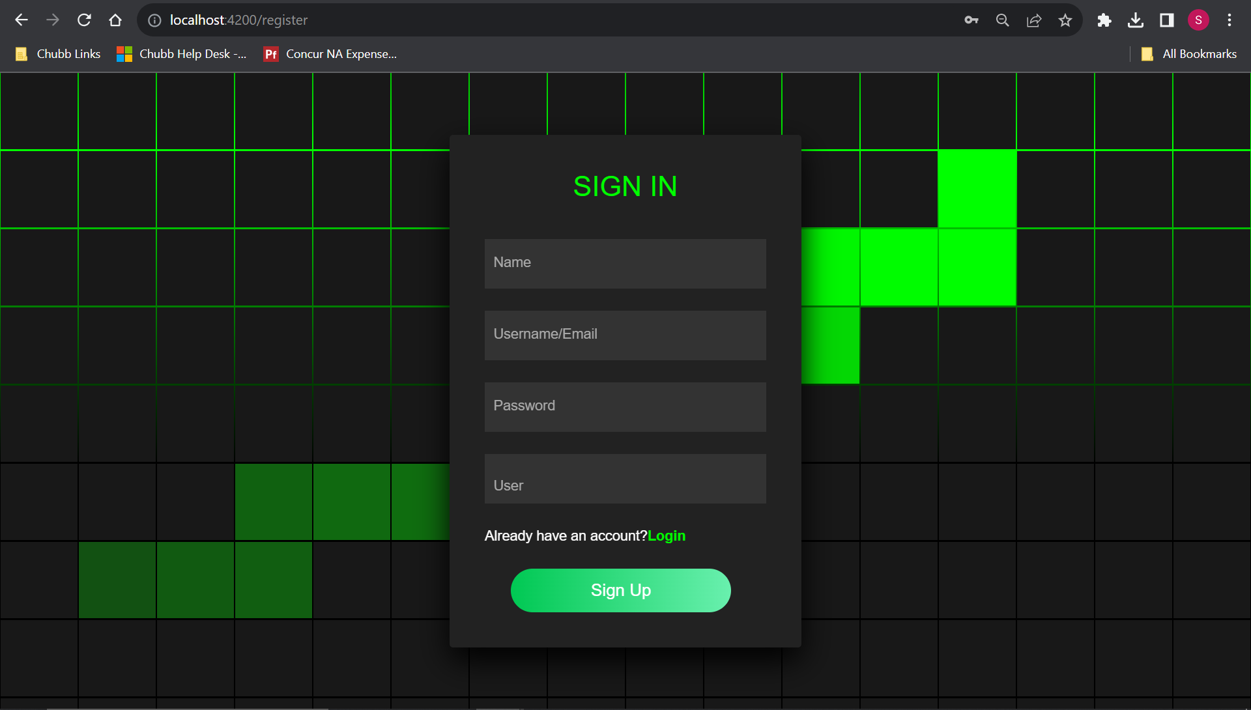
Register Page
If the user is new to the site, they are required to register for an account before they can access the site's features.
During the registration process, users are required to select a role that determines the level of access they will have to the site's features and content.

Slide 5
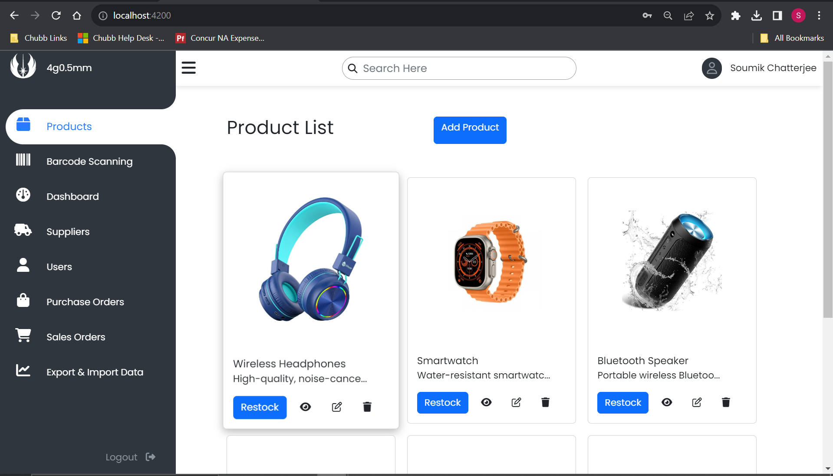
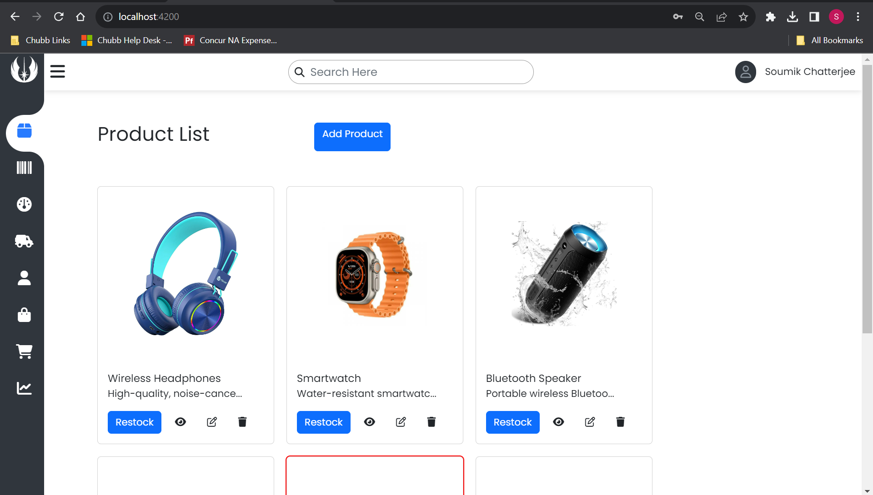
Home Page
After users log in, they are directed to the dashboard homepage.
The dashboard homepage includes a responsive side bar on the left-hand side that allows users to access different components of the site.
By default, the products component is displayed when users arrive on the dashboard homepage.

Slide 6
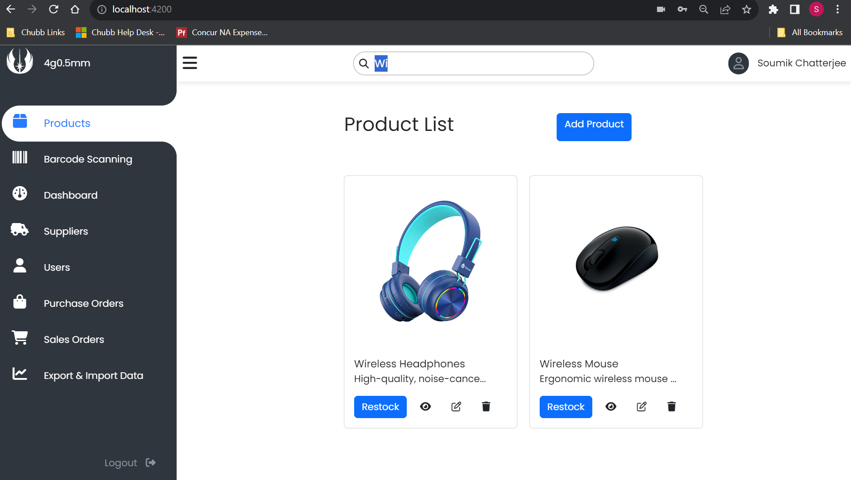
Search Functionality
User can search products using the search bar provided in the dashboard.
The search box comes with automatic routing and searching functionality. This means that users will be directed to the product page as soon as they begin typing in the search bar, and the search results will update in real-time as they continue to type their search query.

Slide 7
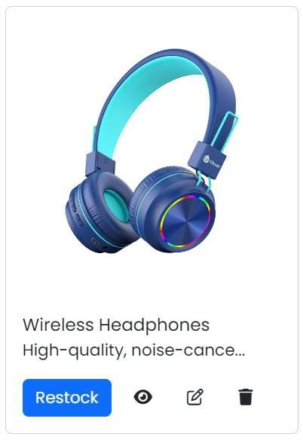
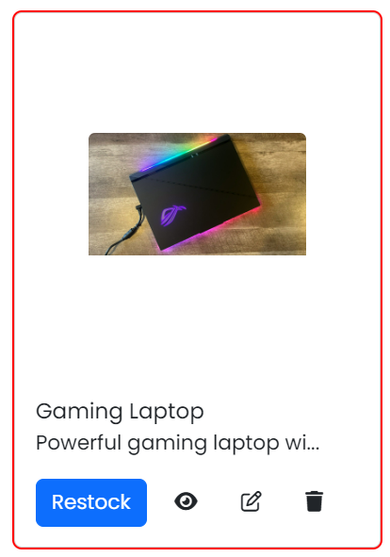
Card
When someone logs in as an admin/manager, they can view product cards that have a restock button, view button, edit button, and delete button to manage inventory efficiently.
The restock button allows admins/managers to refill stock if it runs low, the view button provides access to detailed product information, the edit button enables them to change product details, and the delete button allows products to be removed (only by admin) from the inventory.
When stocks fall below 10, the card appear red to everybody.

Slide 8
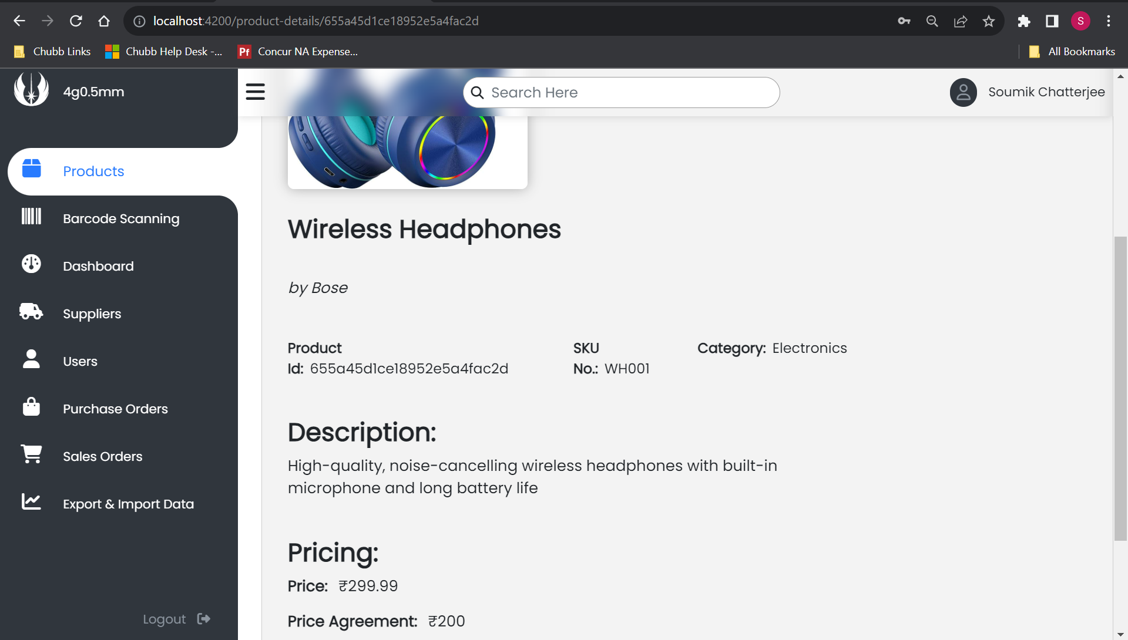
Product Details
The product details page contains all the relevant information related to the product, such as its name, description, price, features, and images.

Slide 9
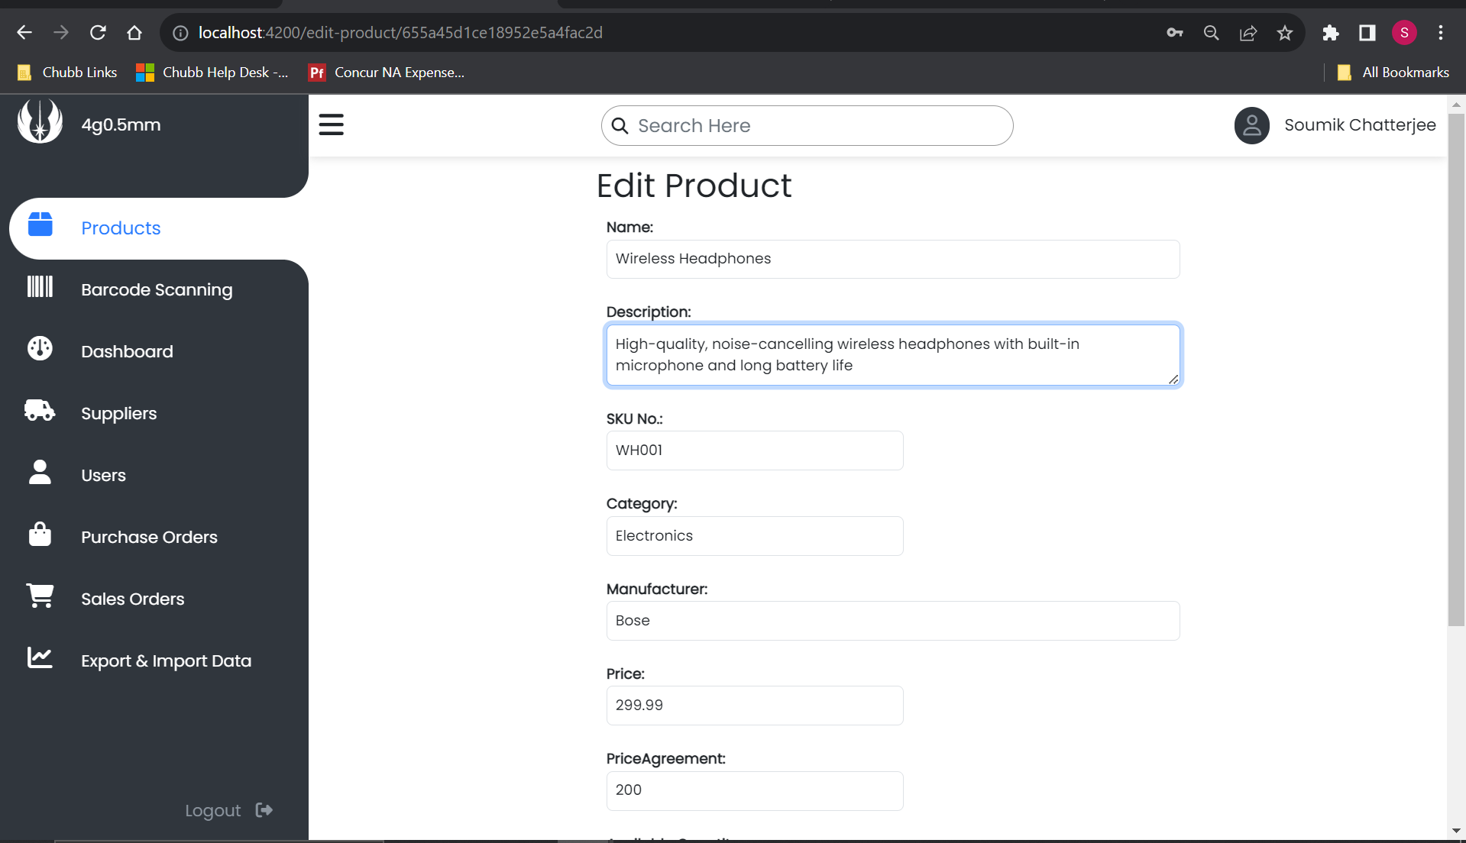
Edit Product Details
The Edit Product Details page allows administrators to modify various details related to a product, such as its name, description, price, features, images, and other relevant information..

Slide 10
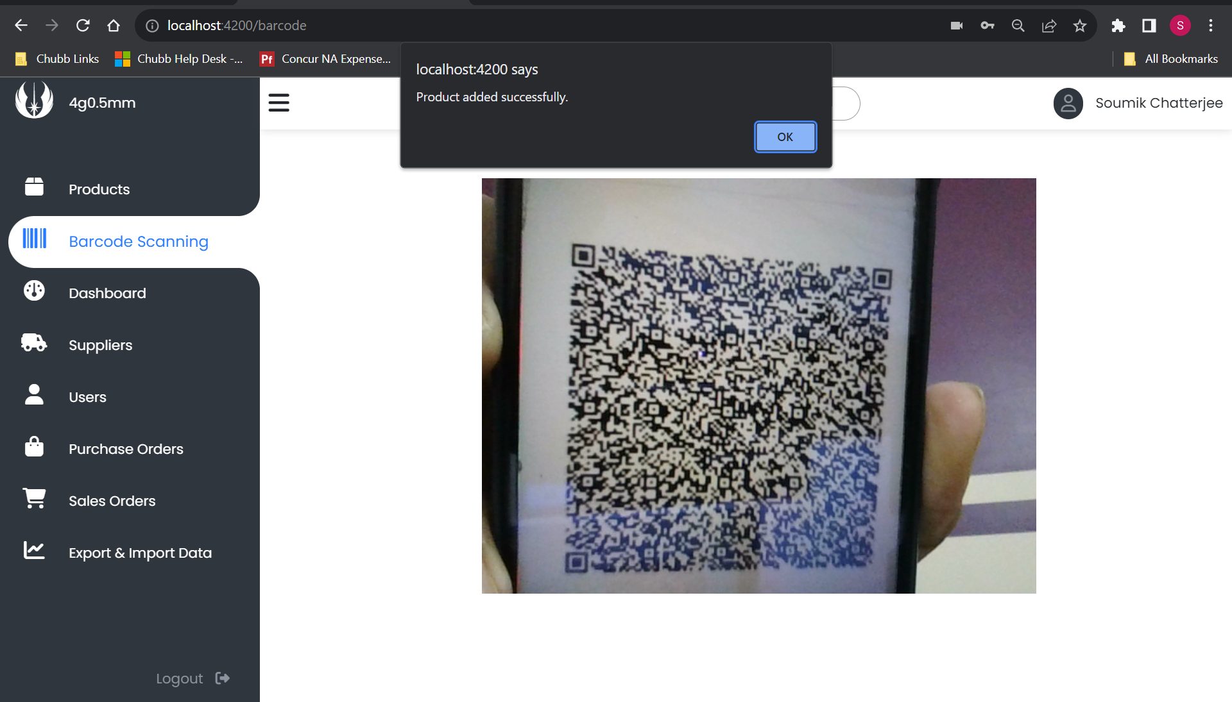
Barcode Scanning
The Barcode Scanning page allows users to add new products to the inventory quickly and efficiently by scanning a QR code that contains the product details in JSON format.

Slide 11
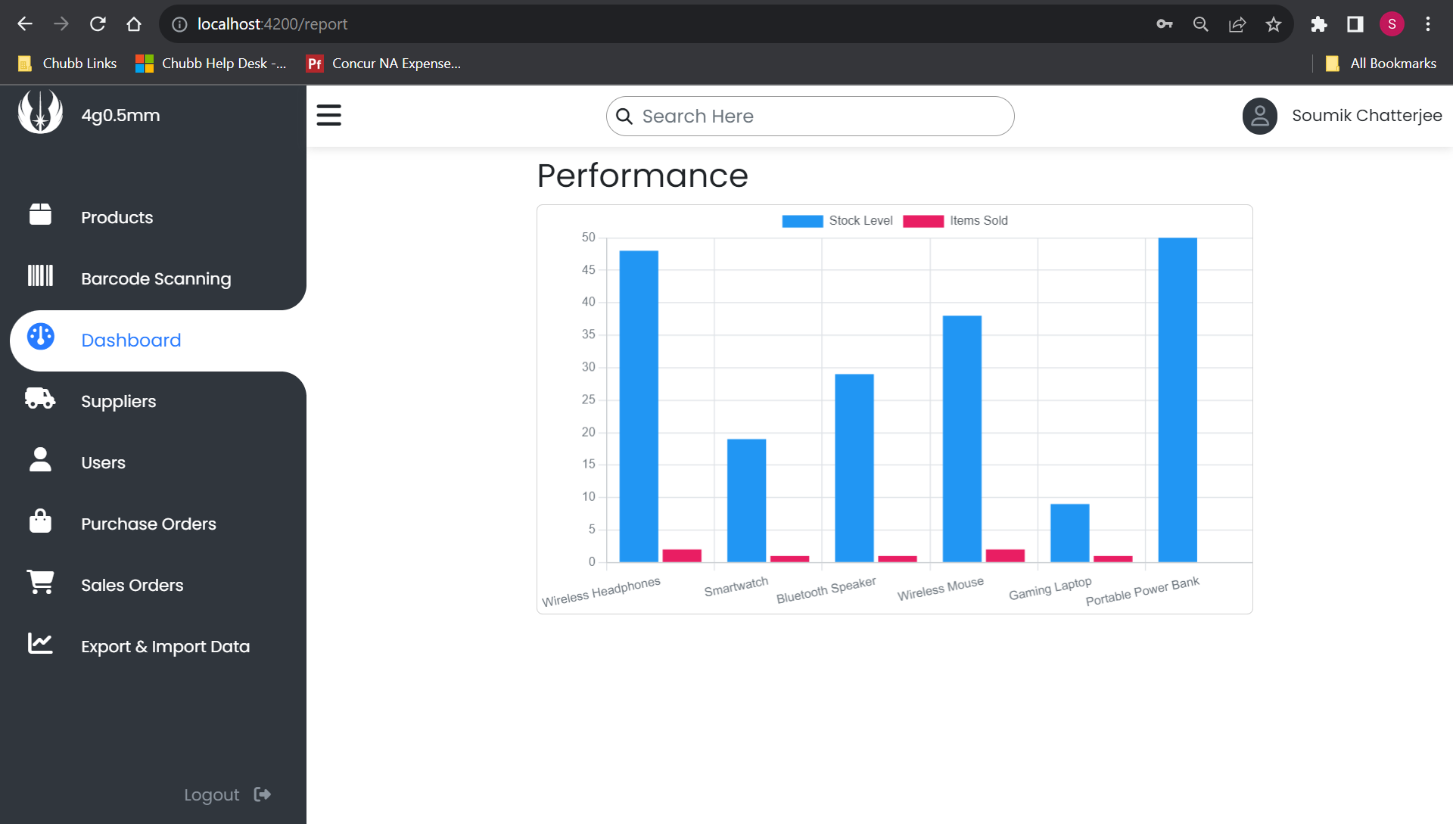
Dashboard
The Performance page provides users with a graphical representation of their inventory stock performance. The graph typically displays the stock level in blue and the number of items sold in red to help users analyze their inventory performance better.

Slide 12
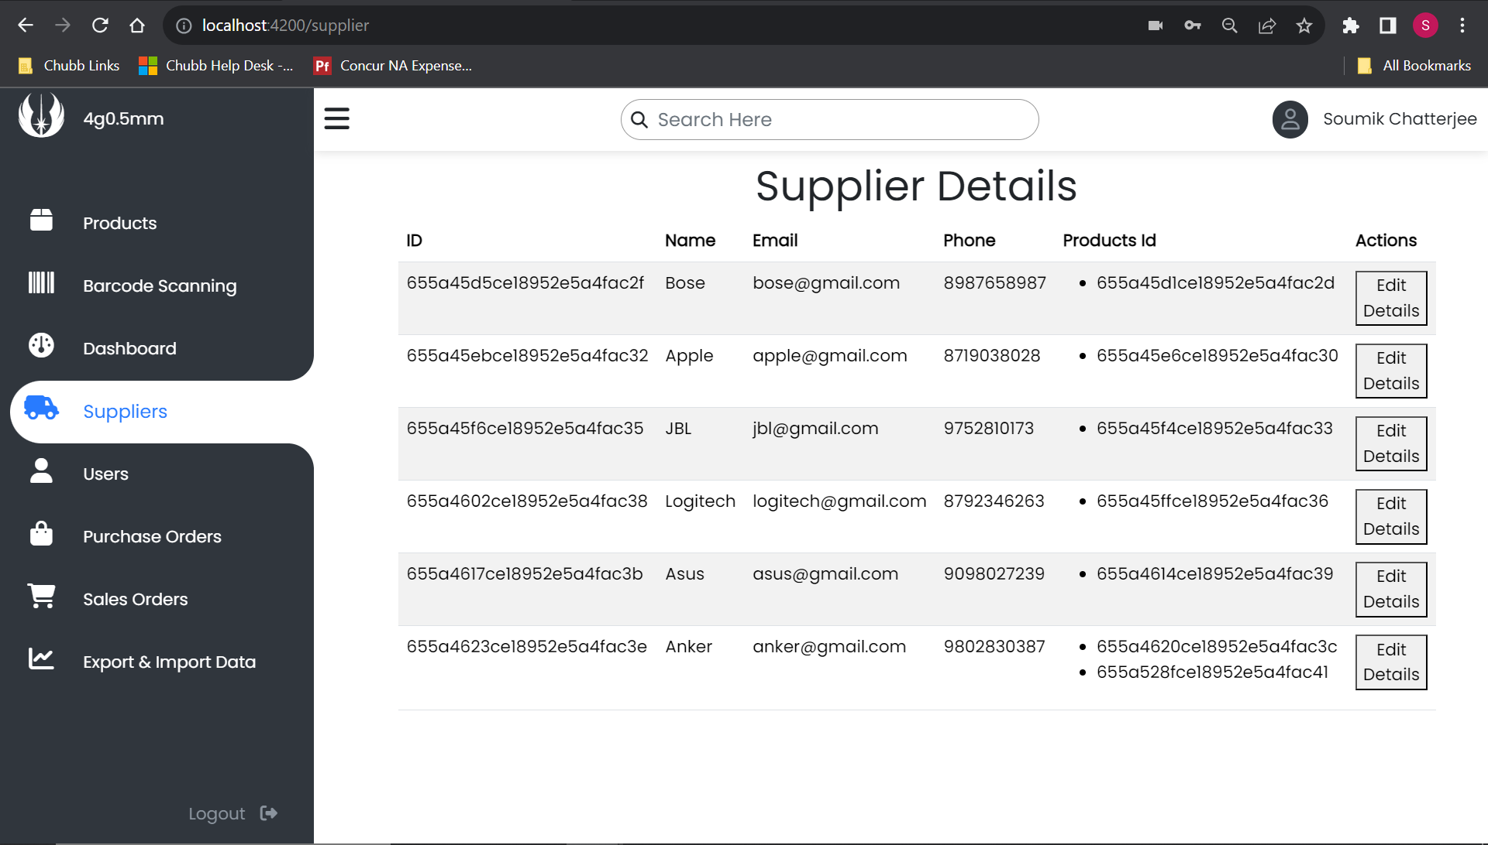
Supplier Details
The Supplier Details page provides users with access to all the relevant information related to a specific supplier, such as their contact details and a list of items they have supplied.

Slide 13
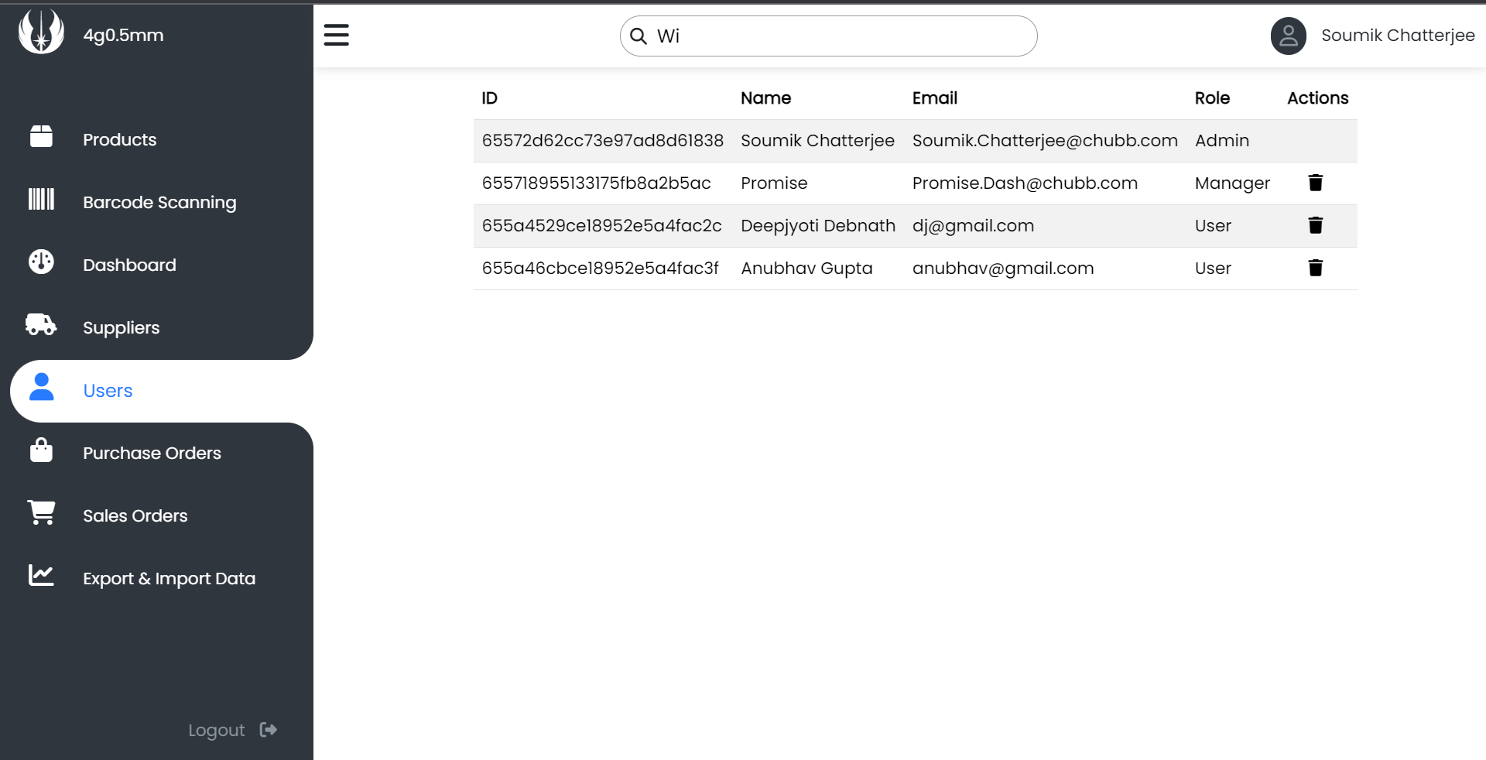
Users List
The User List page allows administrators or managers to view all the registered users of the site and access their corresponding details. Additionally, administrators can remove any user account as deemed necessary from the same page.

Slide 14
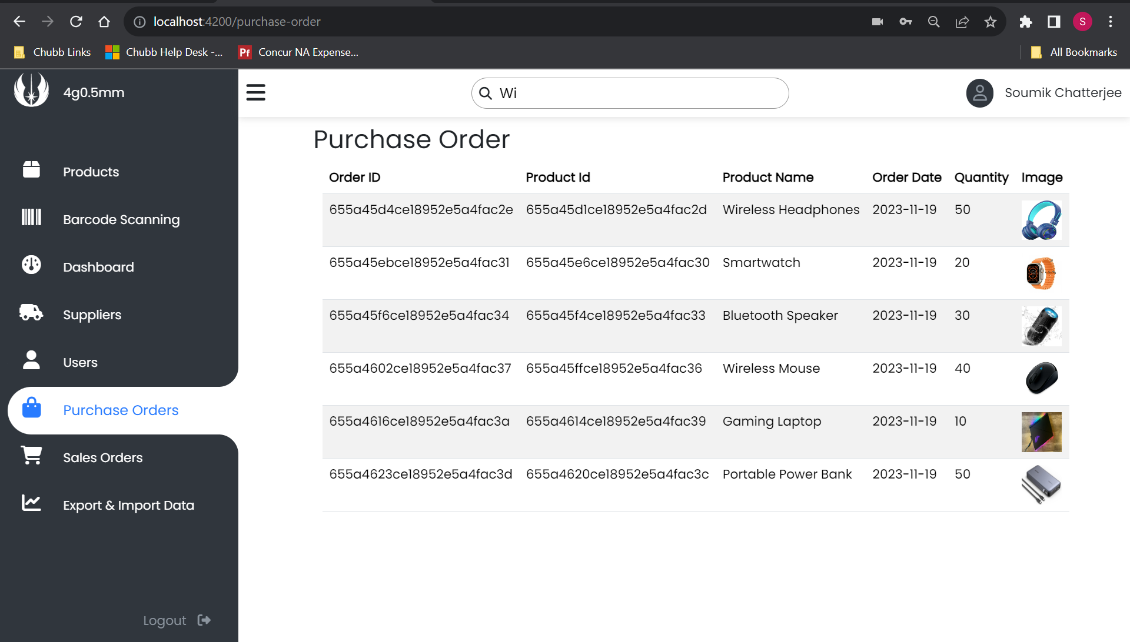
Purchase Order
The Purchase History page displays a detailed summary of the company's past purchases, including the order dates, quantities, and product images.

Slide 15
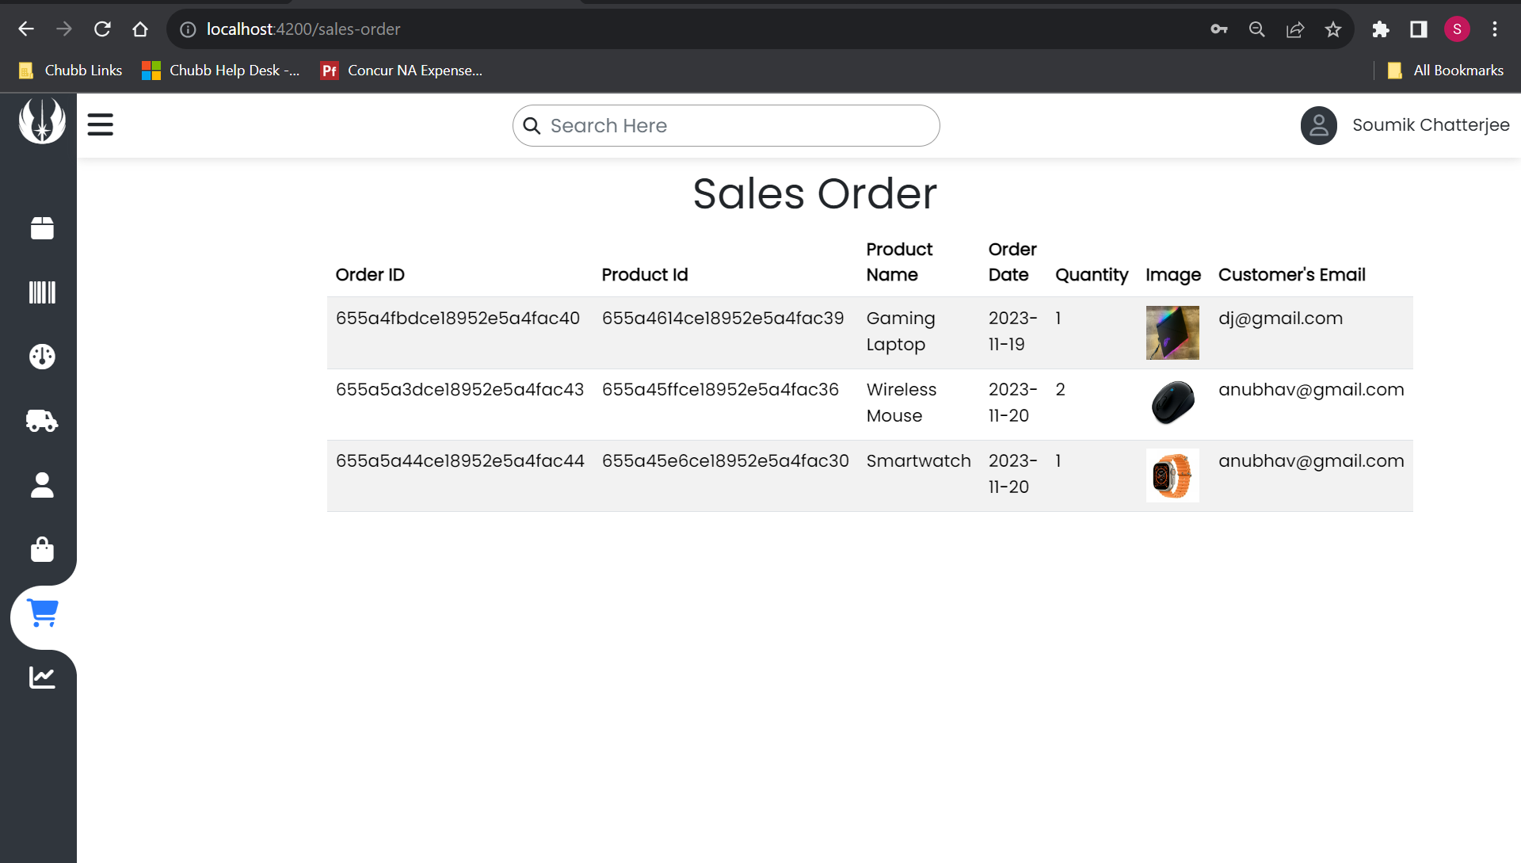
Sales Order
The Sales Order page contains a record of all sales made by the company, including the date of the sale, the quantity of products sold, the product image, and the email address of the customer who purchased the product.

Slide 16
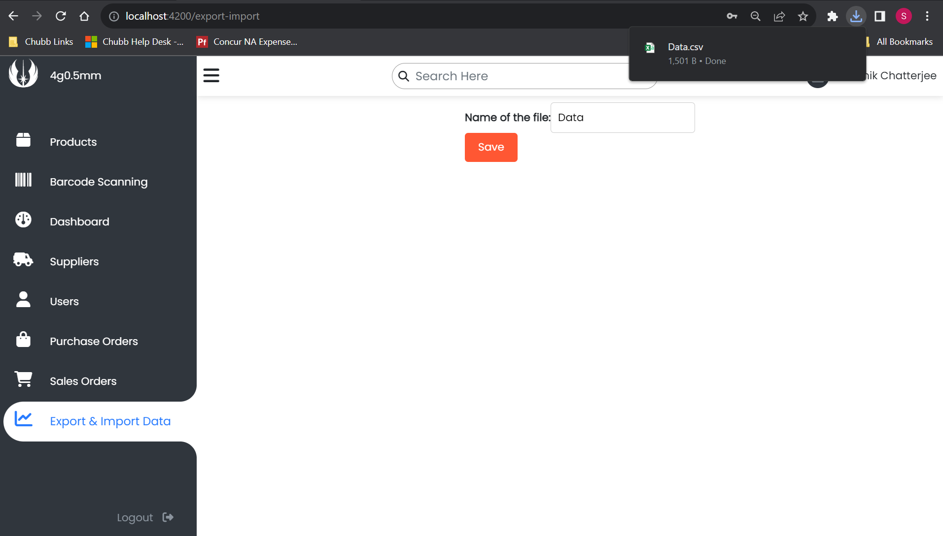
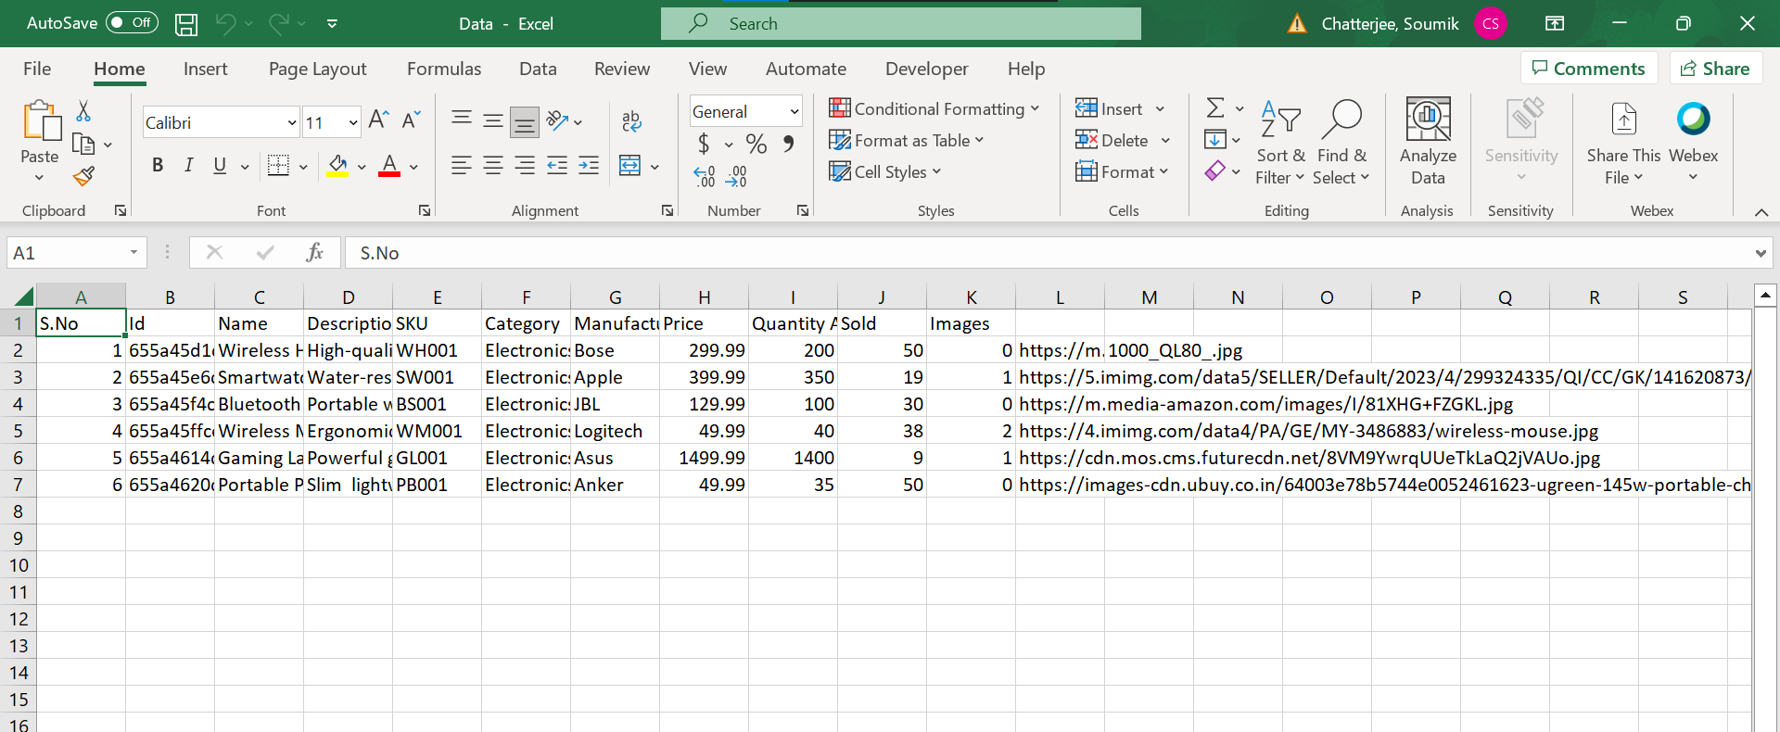
Export Data
One can export the inventory details in csv/excel format.

Slide 17
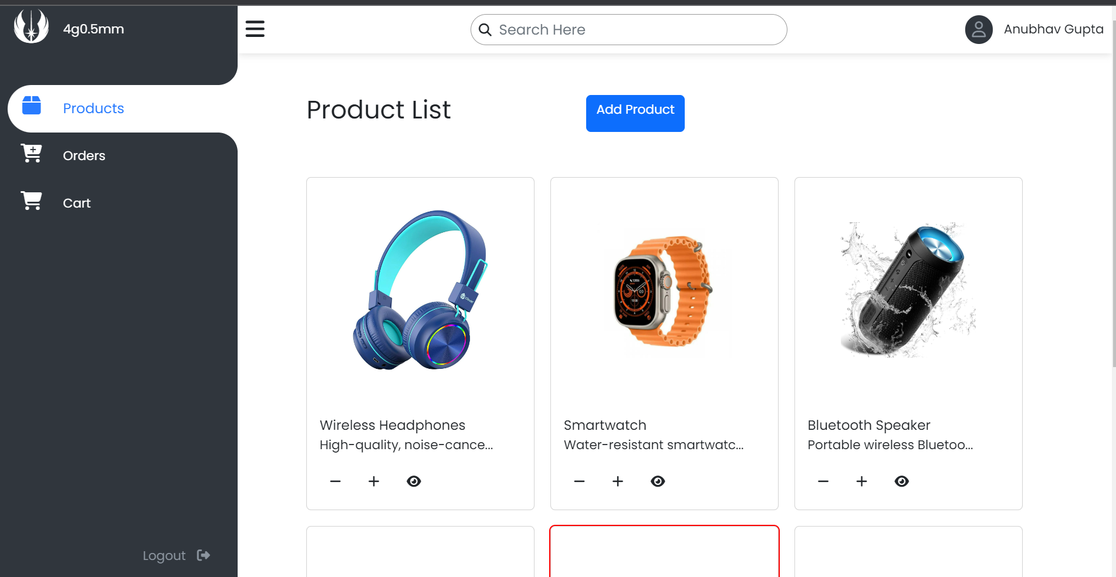
User Login
User pages typically have a limited number of routes compared to administrator or manager pages.
As we can see there are relatively lower routes than Admin/manager

Slide 18
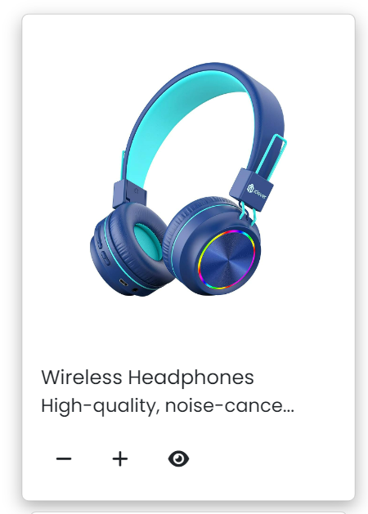
User’s Product Card
The user's card typically includes a + button to add items to their cart, a - button to decrease the cart quantity, and a view button to display further details about the product.

Slide 19
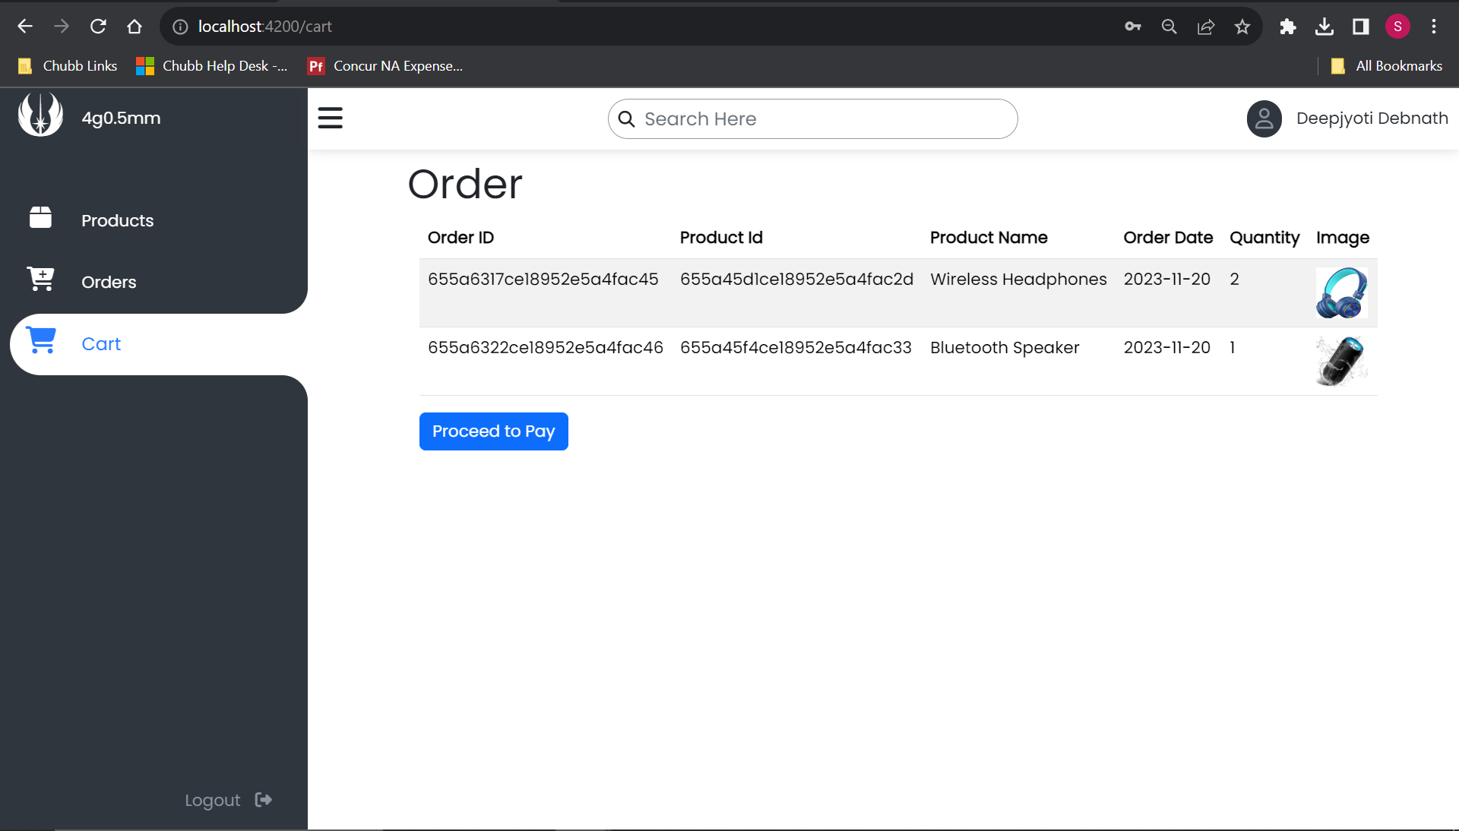
Cart
When a user clicks on the + button to add a product to their cart, it does not have an effect on the original stock quantity of the product.
The original stock quantity will only be updated after the user completes the payment and the order is confirmed or fulfilled.

Slide 20
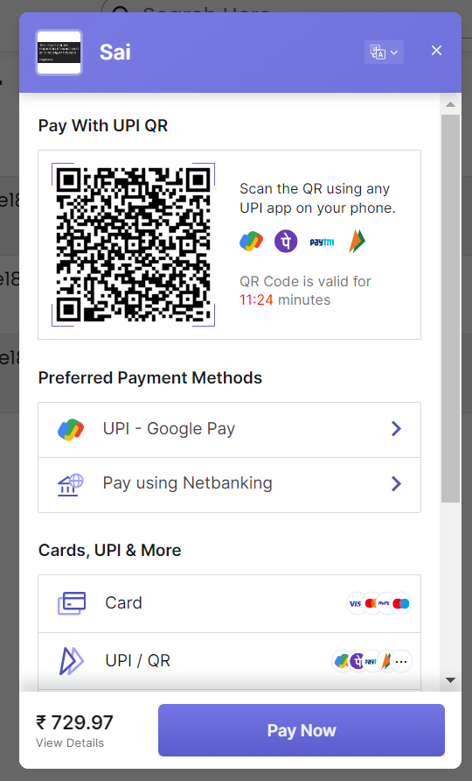
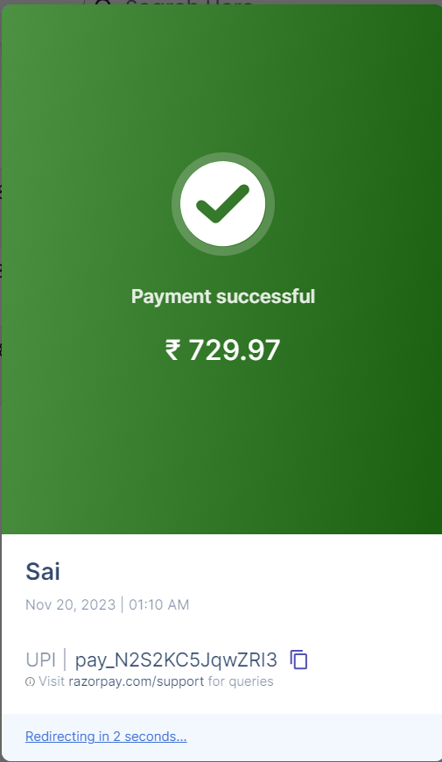
Payment
After clicking on Proceed to Pay, a Razorpay pop-up will appear to complete the payment.
Upon successful completion of the payment, a message confirming payment success will be displayed, and the user will be navigated to the Order page.

Slide 21
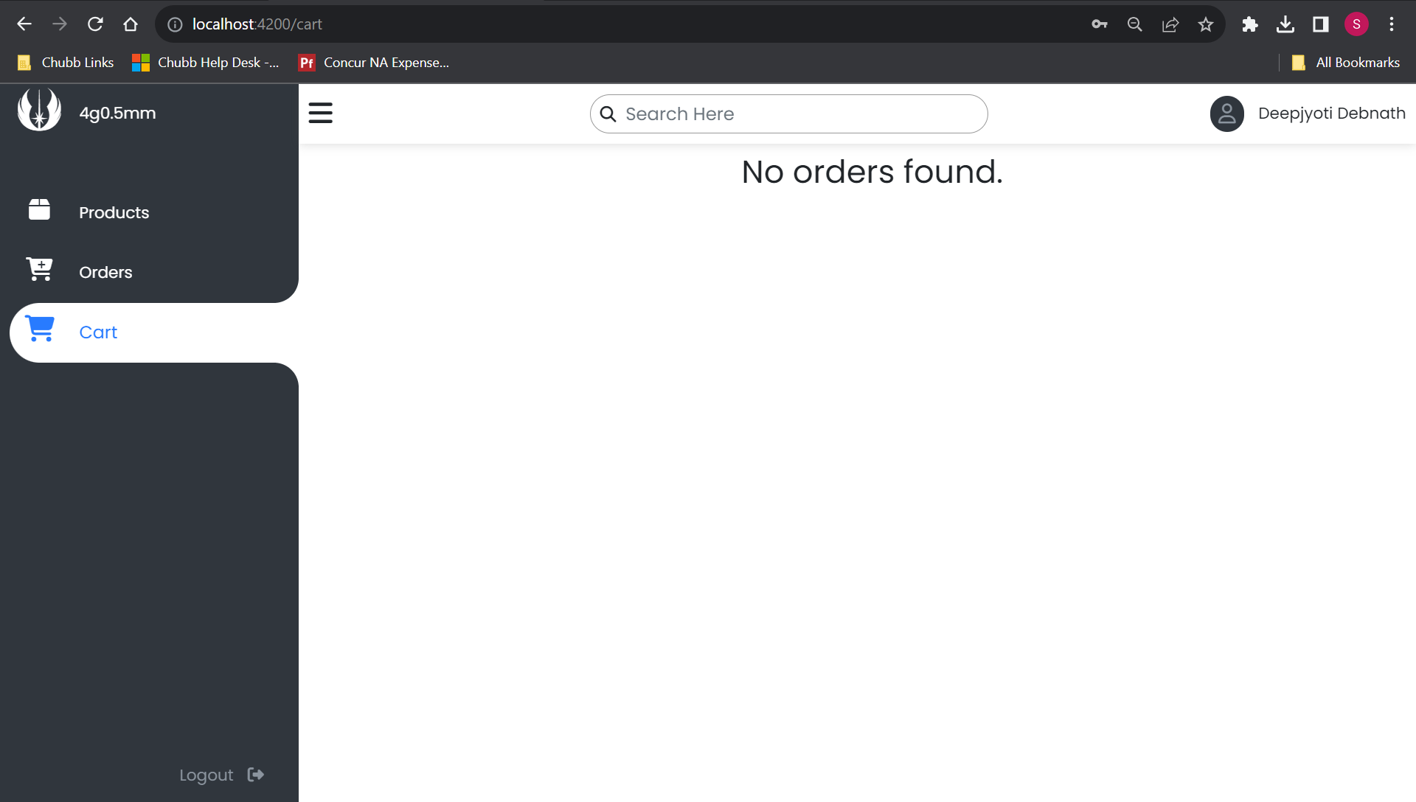
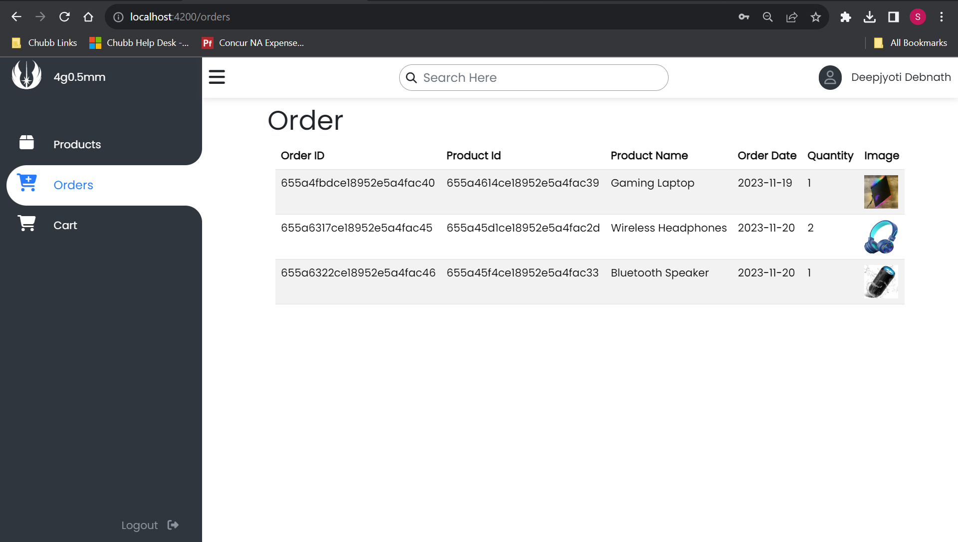
Orders
The Orders page allows users to view all the orders they have made through the site.
After a successful payment, the user's cart is emptied and the order is confirmed, ensuring that the user does not accidentally place duplicate or unnecessary orders.

Slide 22
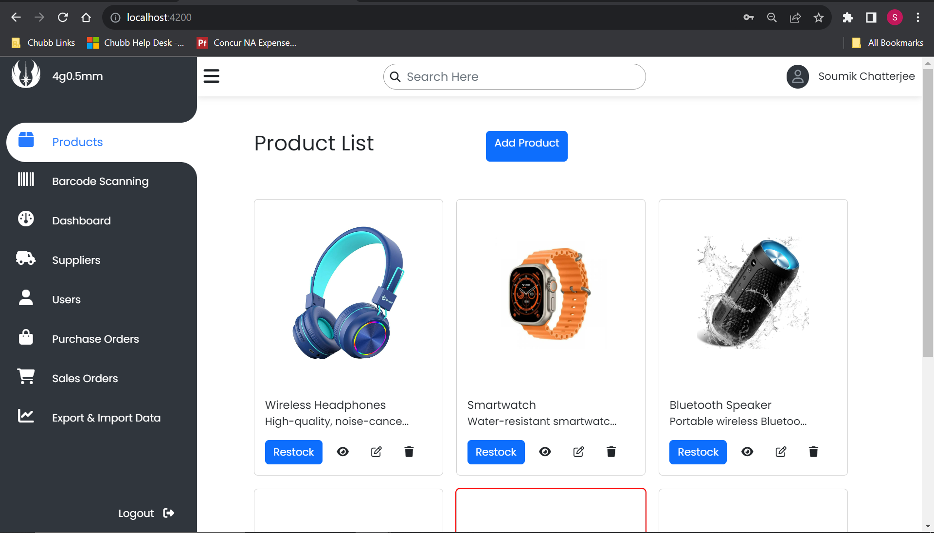
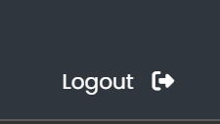
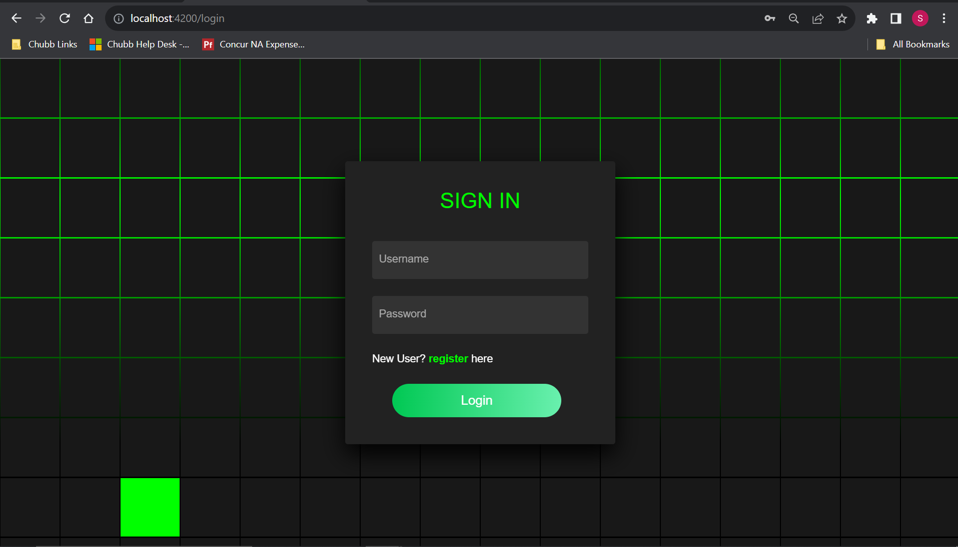
Logout
Users can log out of the application and terminate their session by clicking on the Logout button available in the application.

Slide 23
Thank You

